Slide 1
Spartans
Kickstart ?
FUN
PLAY
OUR GAME
LET THEM PLAY
11 v 11
9 v 9
7 v 7
#LetThemPlay

Slide 2
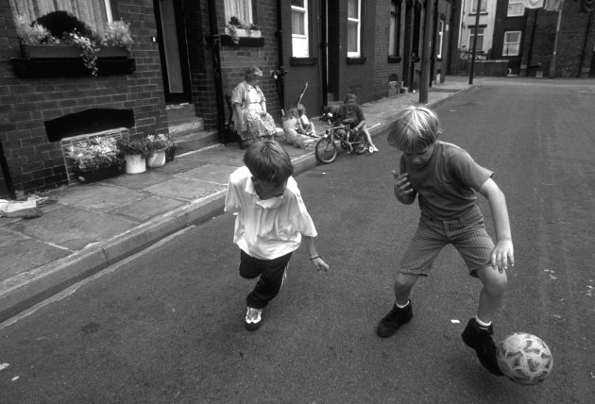
Spartans FC Youth -Kickstart
What is it ?: a new 5-10 minutes warm up game
Why: kids come for FUN , GAMES & PLAY
How does it work ? The easy to set up & run session are now
in all the Fun 4,5 7& 9`s sessions
No coaching Required

Slide 3
What we want to achieve
More game time
More freedom / responsibility / ownership
More interaction with the ball
Better educated coaches + parent helpers
More understanding of benefit of play
Better understanding of children and what makes kids tick
FUN
PLAY
More opportunities for kids…………………to be kids

Slide 4
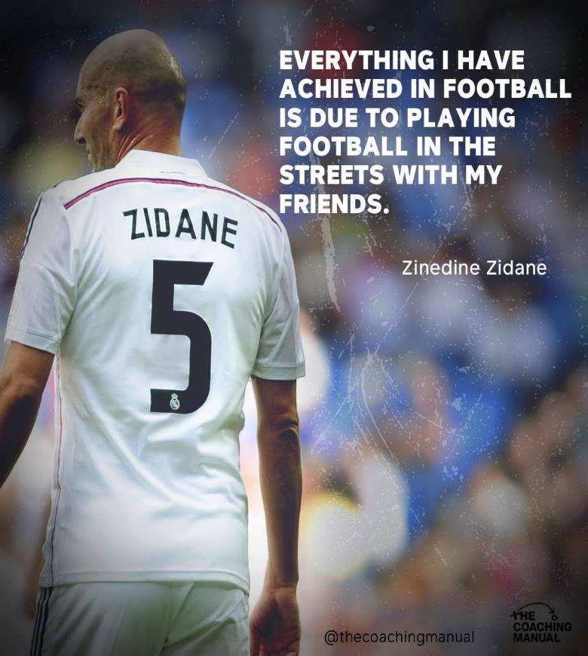
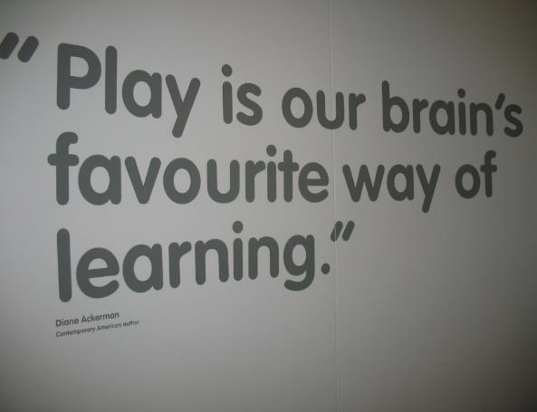
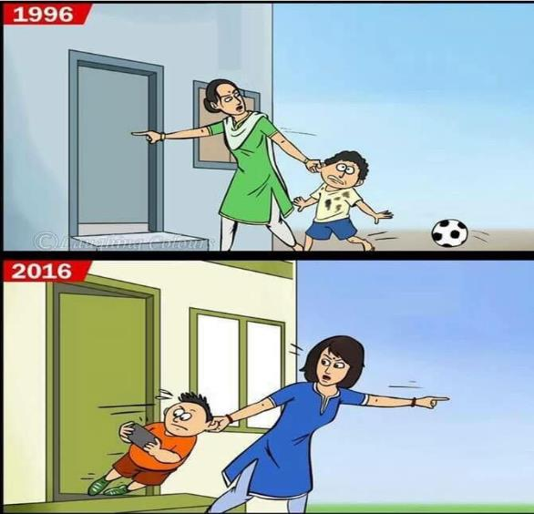

Slide 5
A Games Based Approach…
Problems
Decisions
Solutions
FUN
PLAY

Slide 6
Who is/was you favourite children’s author?
Roald Dahl – what was his best book?
“Life is more fun…..
………if you play games”

